Slide 1


EDA ON NETFLIX MOVIES AND TV SHOWS
Gaurav Sharma
Jan 2020 Batch

Slide 2
Agenda
Case Study
EDA Objectives.
Datasets details and Observation.
Exploratory Data Analysis.
Recommendations.

Slide 3
Case Study
Case study contains dataset of Movies and TV Shows released by Netflix on its platform.
The case study consists of datasets of Netflix Movies and TV Shows and IMDB Ratings.
Netflix Movies and TV Shows (netflix_titles.csv)
List of Movies and TV Shows uploaded on Netflix Platform until January’2020.
There are total 6234 rows and 12 columns
IMDB Datasets:
There are two datasets used from IMDB Open datasets:
"title.basics.tsv" - From this dataset the names of Movies/TV Shows and release year is taken.
"title.ratings.tsv." - From this dataset the ratings for the titles are taken.
There are total 6746319 rows and 9 columns in title.basics.tsv data set.
There are total 1030874 rows and 3 columns in title.ratings.tsv data set.

Slide 4
EDA- Objectives
EDA Objectives
This Exploratory Data Analysis is done as a part of teachings gained during the Term 1 and Term 2 course.
The key actions as part of EDA are loading the dataset, profiling the dataset organizing the dataset, gaining the meaningful insight from dataset.
Based on the observation some questions (as mentioned below) are answered.
EDA Goals:
Ratio of Movies and TV-Shows on Netflix Platform.
Upload trend of contents on Netflix Platform.
IMDB Ratings of contents on Netflix.
Most contributing countries with content on platform overall and for each type.

Slide 5
Datasets Observations
Netflix Movies and TV Shows Dataset
This dataset contains list of Movies and TV Shows uploaded on Netflix Platform until January’2020.
Key column are : type, title, country, date_added, release_year, listed_in.
There are 5 columns with some missing data.
IMDB Basics Datasets
This dataset contains names of content, release year, genres and many more details.
From this dataset we have taken tconst( unique id of each content on IMDB platform, primary title, release year).
There are 14 missing values in primary title column of IMDB dataset.
IMDB Ratings Datasets
This dataset contains ratings of content, number of votes.
From this dataset we have taken into consideration all the columns.
There are NO missing values in this dataset.

Slide 6
Final Dataset Formation for Analysis
At first both IMDB datasets are merged using ‘tconst’ column, which contains unique id of each column.
Merged IMDB datasets are then merged with Netflix Movies and TV Shows datasets using title and release year.
After doing initial profiling on final dataset there was below observation:
There was one duplicate row which have to be removed.
Director: This field has highest Null values around 31% data. It was addressed by filling null values with ‘Mode’ of that column.
IMDB Average Ratings : This field has 29% missing values. It was addressed by filling null values with ‘Mean’ of that column.
numVotes : This field has 29% missing values. It was addressed by filling null values with ‘Median’ of that column.
Cast: This field has around 9% missing data. It was addressed by filling null values with ‘Mode’ of that column.
Country: This field has around 7% missing data. It was addressed by filling null values with ‘Mode’ of that column.
Date_added: This field was of object datatype. It was converted into date time format.

Slide 7
Exploratory Data Analysis

Slide 8
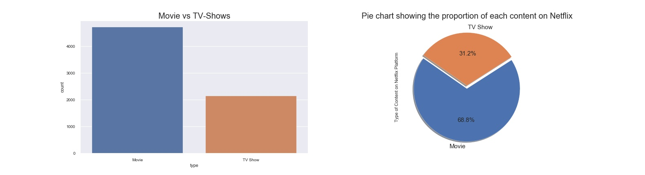
Movies v/s TV-Shows
There are 31.2% content in TV-Shows category and 68.8% content which belongs to Movie category.
This graph clearly indicates the proportion of Movies is much bigger than that of TV- Shows on Netflix Platform.

Slide 9
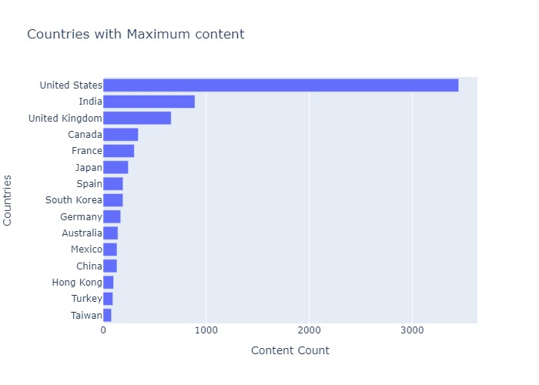
List of top 15 countries producing Maximum content on Netflix
USA, India and UK are the top three countries producing maximum content on Netflix.

Slide 10
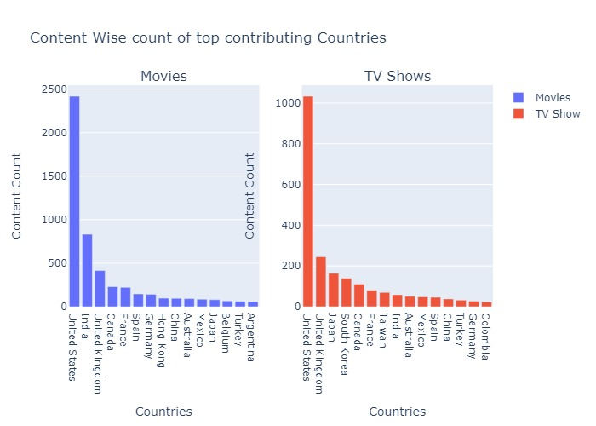
List of top 15 countries producing Maximum content on Netflix of each type.
In the content of Movies, USA, India and UK are the top three countries producing maximum content on Netflix.
While India lags behind in its content for TV-Shows.

Slide 11
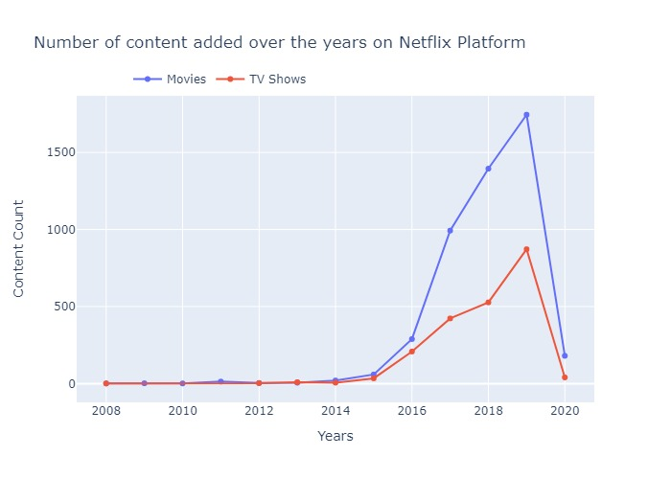
Growth pattern in terms of individual content over the Years?
From the graph it is clear that growth in content over Netflix Platform have increased tremendously after 2016. In that same year Netflix announced its expansion over different countries of the world. Netflix Press Release
There is landslide growth in Movie content since 2016. There is around Six times growth in Movie content on Netflix Platform between year 2016 and 2019.
The growth in TV-Shows content is also quite high since 2016. There is around Four times growth in TV-Shows content on Netflix Platform between year 2016 and 2019

Slide 12
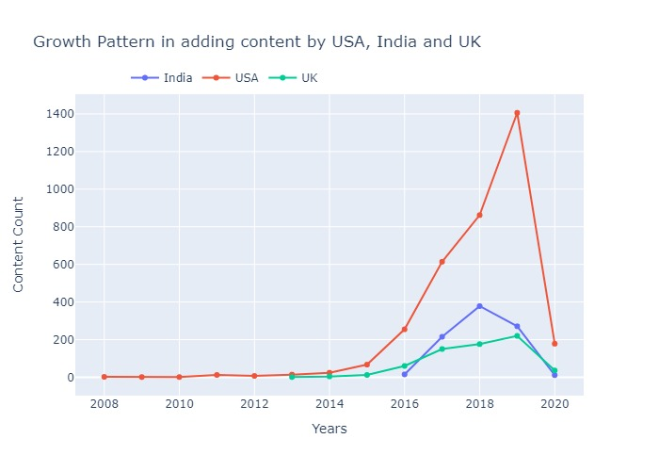
Growth pattern in adding the content on Netflix for USA, India and UK over the Years?
In the above graph we compare the growth pattern of top three contributing countries.
Netflix started adding the contents on its platform since 2008 in USA, in UK since 2013 and in India since 2016.
Netflix India journey started three years after UK, still it managed to surpass the former in terms of content contribution and manged to secure 2nd position of all the countries in the world.
In 2018 there was maximum content added on Netflix platform from India but we can see the fall in count of contents added on Netflix Platform in 2019.
Whereas in USA maximum content was added in 2019. By Far USA is the highest contributor of contents over the platform.

Slide 13
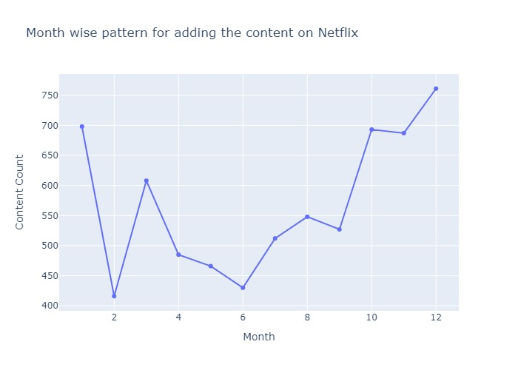
Month wise pattern for adding the contents on Netflix?
Most of the contents are added in between the months of October to January.
Owing to the Holiday seasons in many part of the countries during this month the content count seems to be high during these months.

Slide 14
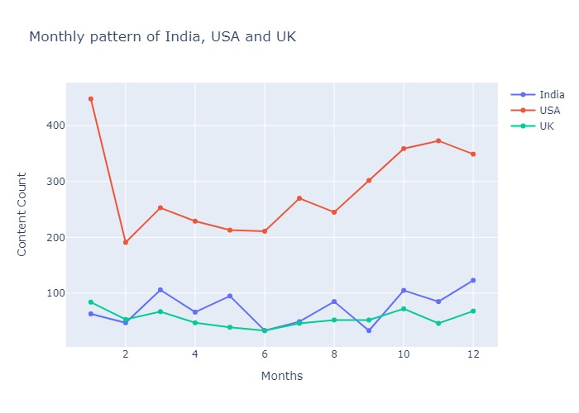
Monthly growth pattern in adding the content on Netflix for USA, India and UK?
USA
USA's maximum contribution is during the month of October to January. During this time holiday season starts so there is a rise in content count during these months.
USA has added 448 contents in total in January Month alone.
USA has added least amount of content in the month of February.
INDIA
India's maximum contribution is during the month of October, December and March. Upload pattern from India doesnot depend highly on Holiday seasons.
India has added in total of 123 contents only in month December which is the highest overall contribution of a particular month.
India has added least amount of content in the month of June and September.
UK
UK's maximum contribution is during the month of January.
UK has added 84 contents in total in January Month.
UK has added least amount of content in the month of June.
UK's content contribution during each month is quite steady. There are no major Up's and Down in the graph of UK.

Slide 15
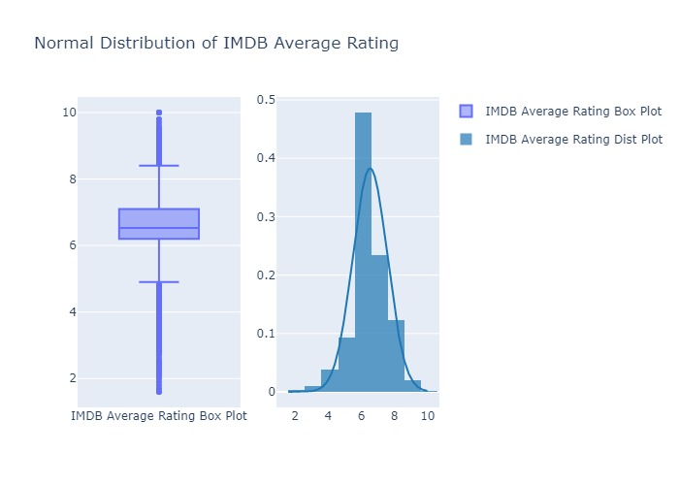
Distribution of average IMDB rating?
Average IMDB rating for contents on Netflix is 6.529.
Median IMDB rating for contents on Netflix is 6.529.
Mean and Median is same so we attain a Normal Distribution Curve of IMDB Ratings for contents on Netflix.
IMDB Rating is between IQR range of (q1 = 6.2 and q3 = 7.1) which is 0.9.
Upper and Lower fence is at 8.4 and 4.9 respectively.

Slide 16
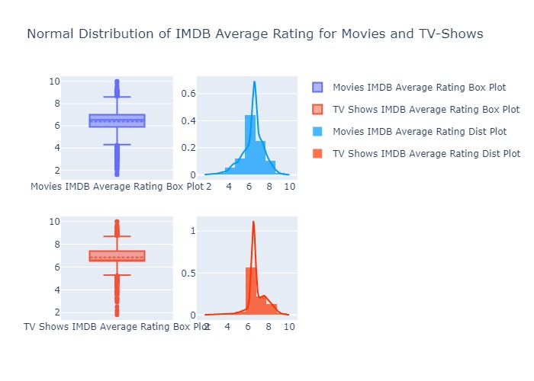
Distribution of average IMDB rating for Movies and TV-Shows?
Movies
Average IMDB rating of Movies on Netflix is 6.38.
Median IMDB rating of Movies on Netflix is 6.529.
Mean and Median is not same. There is Left Skewness in IMDB Ratings for Movies on Netflix.
IMDB Rating is between IQR range of (q1 = 5.9 and q3 = 7.0) which is 1.1.
Upper and Lower fence is at 8.6 and 4.3 respectively.
TV Shows
Average IMDB rating of TV Shows on Netflix is 6.85.
Median IMDB rating of TV Shows on Netflix is 6.529.
Mean and Median is not same. There is Right Skewness in IMDB Ratings for TV Shows on Netflix.
IMDB Rating is between IQR range of (q1 = 6.529 and q3 = 7.4) which is 0.87.
Upper and Lower fence is at 8.7 and 5.3 respectively.

Slide 17
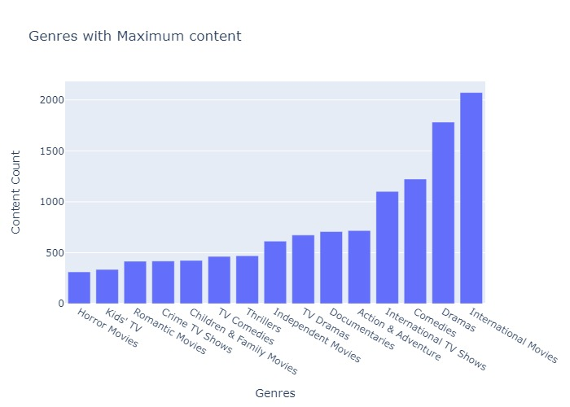
Top 15 Genres having maximum content?
International Movies and Dramas have more than 1500 contents on platform

Slide 18
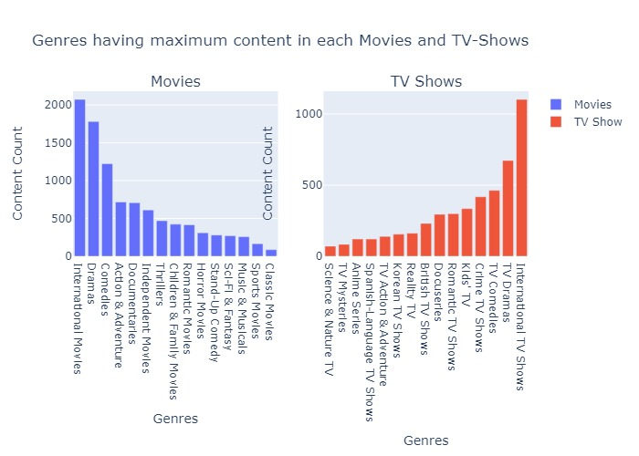
Top 15 Genres having maximum content in each Movies and TV-Shows?
International Movies and TV Shows have the maximum content. This might be because the international language contents might have been assigned this genre.
Dramas and Comedies holds 2nd and 3rd spot respectively for both Movies and TV-Shows.

Slide 19
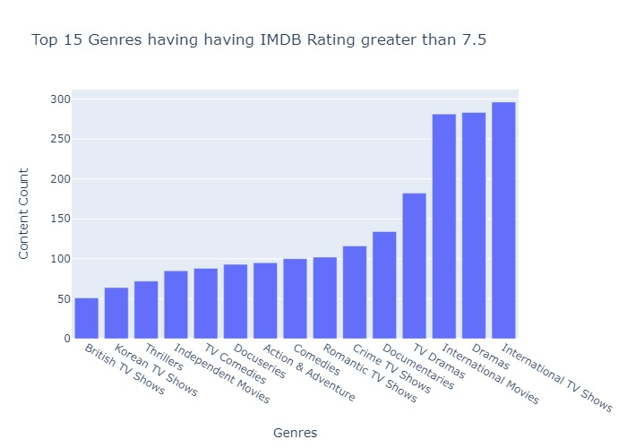
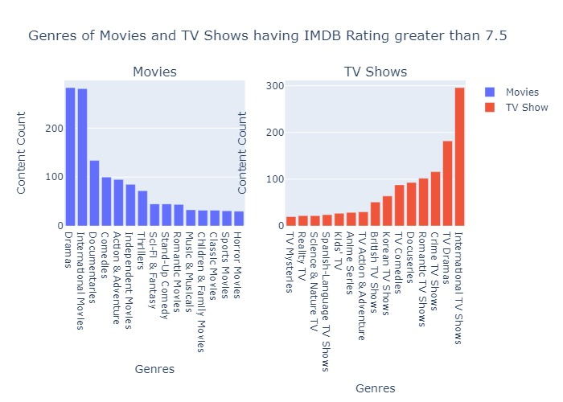
Top 15 Genres having IMDB Rating greater than 7.5, overall and in individual content type ?
Above 7.5 IMDB Rating we have International TV Shows, Dramas, Movies in top three.
Though TVS-Shows content are less in number as that of Movies but they are most liked by the audience.
Comedies are not much liked by audience though their content count is higher as seen in above analysis.

Slide 20
Conclusion
It is analyzed that the Movies holds greater percent of share than TV-Shows on Netflix Platform.
Since 2016 there is phenomenal rise in content on Netflix platform every year.
Netflix releases content in USA bearing the holiday seasons in mind which can be confirmed after see the month upload pattern of USA.
Average IMDB rating of the contents on Netflix is around 6.5.
Recommendations
While analyzing the Monthly upload pattern of USA, UK and India it was noticed that Netflix keeps in mind the holiday sentiment of USA, where as we see that to be it is not reflecting much for other countries.
India has the potential of becoming a very profitable market for the growth of company as it is the second largest provider of content on its platform though Netflix was launched in India three years back only.
The quality of the content need to be slightly improved. Mean IMDB rating of its content is 6.5 while major content lies in between the rating of 6.2 to 7.1. The lower fence was at the rating of 4.9 and Upper fence is at the rating of 8.4. Lower fence of box plot need to be improved.
Netflix need to reevaluate the likeness of people, basically what type of content they like watching for both Movies and TV-Shows. For example from above analysis we saw that the contents under the Genre of Comedies was third in number whereas when we see its IMDB rating it has received low ranking

